Slide 1
Employee Data Analysis Report Analyzing Salaries, Overtime, and Performance metrics
Presented by Muhammad Aliansyah Ramadhan
HR Data Analyst & Engineer
Notes:
"Good afternoon, everyone. Thank you for joining this presentation. Today, I will be sharing the results of our 'Employee Data Analysis Report,' focusing on factors such as salaries, overtime, and performance metrics across departments. My name is [Your Name], and I’m an HR Data Analyst. Let's dive into the insights and recommendations."

Slide 2

Background
Employees are the primary asset of every company.
Analyzing salary, work performance, leaves, and overtime is crucial to improve employee well-being and retention.
This report aims to explore various factors that impact employee satisfaction and productivity.
Notes:
"As we all know, employees are a company's most valuable asset. Analyzing aspects like salary, work performance, leaves, and overtime can greatly improve both employee well-being and retention. In this report, we’ll explore factors that impact employee satisfaction and productivity, which will help the HR team and management make informed decisions."

Slide 3
OBJECTIVES
Evaluate salary distribution across departments and locations
Analyze the relationship between work duration and employee retention.
Investigate the impact of overtime on employee impact
Provide insights for HR policies to enhance employee welfare.
Notes:
"The objectives of this analysis are fourfold:
To evaluate salary distribution across different departments and locations.
To analyze the relationship between work duration and employee retention.
To investigate how overtime impacts employee performance.
And lastly, to provide insights for HR policy improvements that will enhance employee welfare."

Slide 4
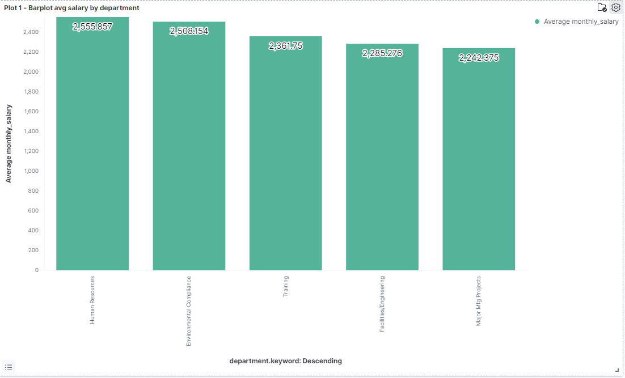
Salary by Department
Notes:
"Our first analysis focuses on salary distribution by department. Interestingly, the Human Resources department has the highest average salary, while the Major Manufacturing Project department records the lowest average salary at 2,242. It’s also worth noting that both Facilities and Engineering departments, which require more physical and mental effort, are on the lower end of the salary scale. My recommendation here is to adjust the salary scales to retain talent, especially in these demanding departments."

Slide 5
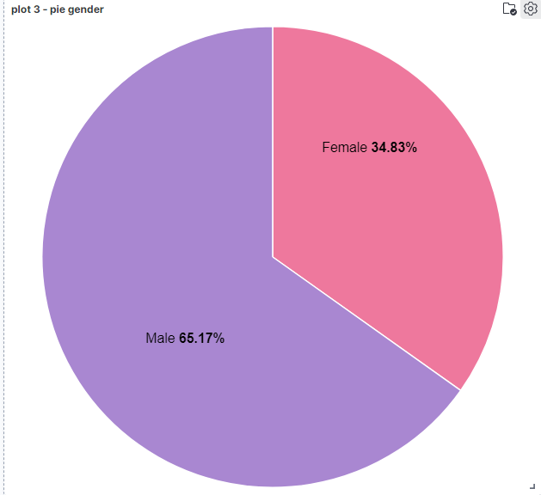
Gender Distribution of the Company
• Male employees make up 65.17% of the workforce.
• Context: In the Middle East, societal norms influence the lower female workforce participation.
• Women employed likely have family support to pursue careers.
• Recommendation: Consider promoting more inclusive hiring practices.
Notes:
"Next, we looked at the gender distribution in the company. Currently, male employees make up 65.17% of the workforce. This reflects societal norms in the Middle East, where workforce participation by women is influenced by family support. To address this, promoting more inclusive hiring practices may help us move towards a more balanced workforce."

Slide 6

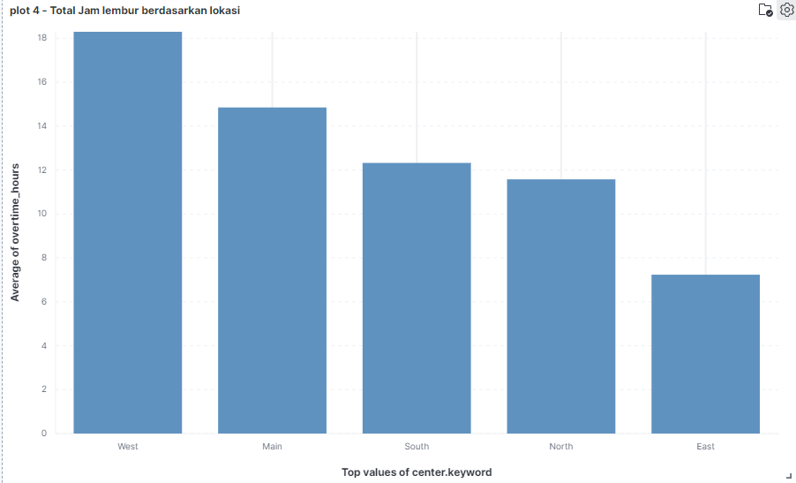
Overtime Analysis by Branch
Key Insight: The West branch has the highest overtime hours due to a higher workload
East branch has the lowest overtime, with Main branch in the middle.
Recommendation: Redistribute workloads to reduce overtime and prevent employee burnout.
Notes:
"Now, let's move to overtime distribution across branches. The West branch has the highest overtime due to heavier workloads, while the East branch has the lowest overtime hours. To avoid burnout, my recommendation is to redistribute workloads more evenly across branches, ensuring a better work-life balance for all employees."

Slide 7
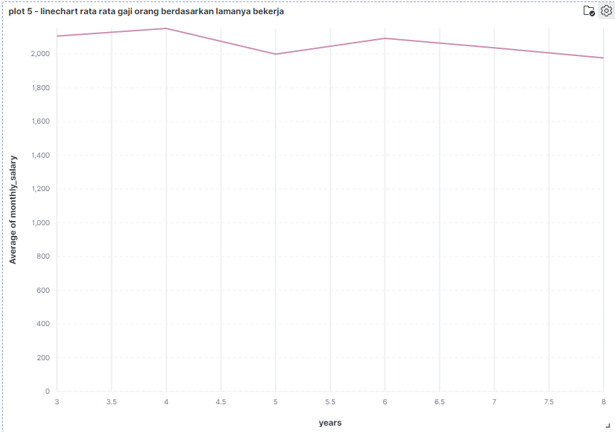
Work Duration and Salary Correlation
No significant relationship between years worked and salary.
Salaries peak at 4 years of service, then decline after 6 years.
Recommendation: Consider refreshing the workforce by laying off employees after 6 years, to bring in new talent with innovative ideas.
Notes:
"Here, we analyzed the correlation between work duration and salary. Surprisingly, there’s no significant relationship. Salaries peak around four years of service but start to decline after six years. This suggests that we may want to refresh the workforce by considering layoffs for employees after six years of tenure, making room for new talent and innovative ideas."

Slide 8
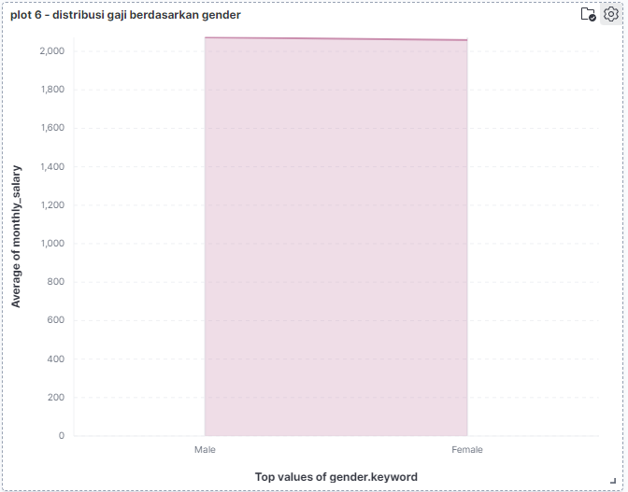
Gender-based Salary Comparison
Average salary for male employees: 2,100.
Average salary for female employees: 2,050.
Key Insight: No significant gender-based salary discrepancy, indicating fair pay practices.
Recommendation: Continue promoting equality in pay across genders.
Notes:
"In this slide, we compare salary averages between male and female employees. The results show no significant discrepancy, with men earning an average of 2,100 and women earning slightly less at 2,050. This indicates that our pay practices are fairly balanced, though we should continue promoting pay equity to maintain fairness."

Slide 9
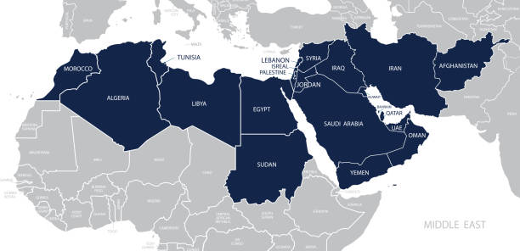
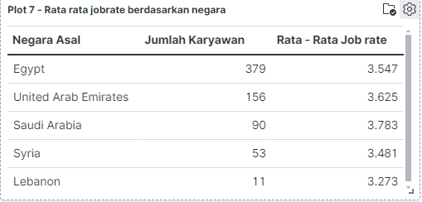
Performance and Work Rate by Country
Average salary for male employees: 2,100.
Average salary for female employees: 2,050.
Key Insight: No significant gender-based salary discrepancy, indicating fair pay practices.
Recommendation: Continue promoting equality in pay across genders.
Notes:
"Here, we analyzed employee performance across different countries. Egypt remains our largest source of employees, which makes sense since we are based there. However, Lebanese employees are showing the lowest work rate. This could be due to training gaps or language barriers. My recommendation is to provide additional training for Lebanese employees and offer rewards or bonuses to high-performing employees from countries like Saudi Arabia."

Slide 10
KEY TAKEAWAYS
SALARY
WORKLOAD
INNOVATIVE POLICIES
FAIR PAY
Salary adjustments needed in high-effort departments.
Workload redistribution required to reduce overtime.
Consider innovative HR policies for long-serving employees.
Promote fair pay and inclusive hiring practices.
REWARD
Implement a rewards system for high-performing employees.
Notes:
To summarize, our key takeaways from this analysis are:
We need to adjust salaries in high-effort departments like Engineering and Facilities.
Redistributing workload across branches is critical to reducing overtime.
Implementing innovative HR policies for long-serving employees will help maintain fresh talent.
Promoting inclusive hiring and fair pay practices remains important.
Finally, implementing a rewards system for high performers will drive motivation and retention."

Slide 11
RECOMMENDATIONS
RECOMMENDATIONS 1
RECOMMENDATIONS 2
RECOMMENDATIONS 3
SOLUTION 4
Adjust salary based on workload and department.
Redistribute workload across branches to prevent burnout
Introduce fresh talent while balancing experienced workers.
Implement rewards for employees with high work rates.
Notes:
"In terms of actionable recommendations, I suggest:
Adjusting salaries based on workload and department.
Redistributing workload more evenly to prevent burnout.
Refreshing the workforce by balancing experienced workers with new talent.
And finally, implementing a rewards system for employees with high work rates to recognize their contributions."

Slide 12
THANKS!
Does anyone have any questions?
Please keep this slide for attribution
Notes:
"Thank you all for your time. I hope the analysis and recommendations provided valuable insights. I’m happy to answer any questions you might have."

Slide 13


